Slide 1

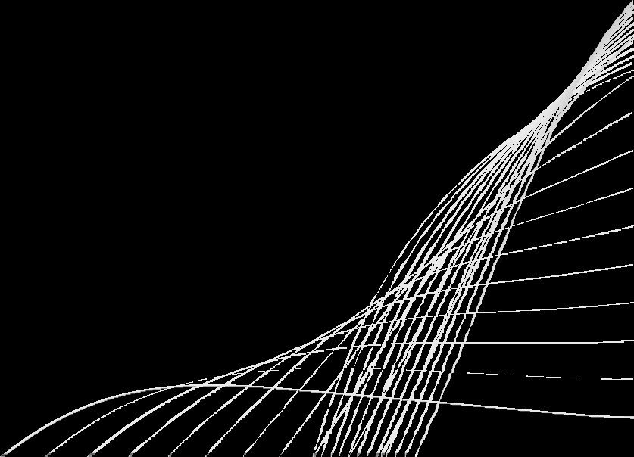
Edge Computing – Review 2
(TEAM-18)
Project Title
An Adaptive AIoT Solution with Dynamic Sensor Group Selection for Real-Time Traffic Monitoring and Energy Efficiency Towards Smarter Cities (Resource Allocation)
GOAL
To design an adaptive AIoT-based framework that dynamically selects sensor groups
for real-time traffic monitoring, ensuring accurate data collection while optimizing energy use and resource allocation in smart cities.

Slide 2

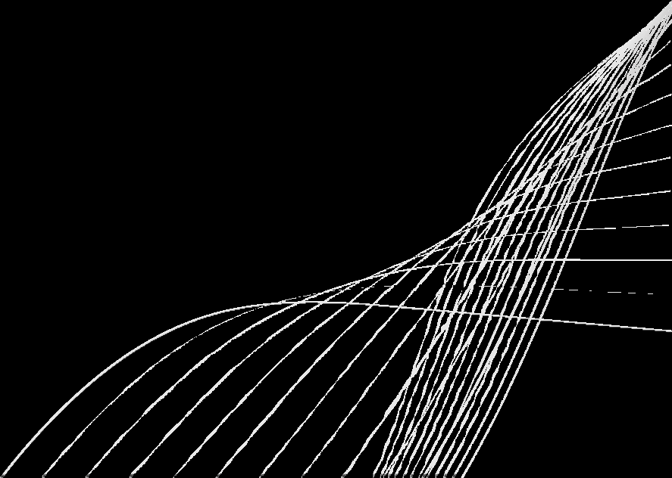
Review 1 Recap
What we presented in Review 1:
Basic concept of Energy Managament and latency optimaization
Basic concept of driver drowsiness detection.
Idea of edge decision-making but not fully structured.
01

Slide 3


Changes & Improvements (Review 1 → Review 2)
Added ContextGeneratorModule
Integrated Python ML models (drowsiness + priority).
Implemented V2V communication
Built AdaptiveAllocatorModule
Maintained continuous GitHub commits with clear messages. cleint server model
Updated Architecture Diagram
02

Slide 4

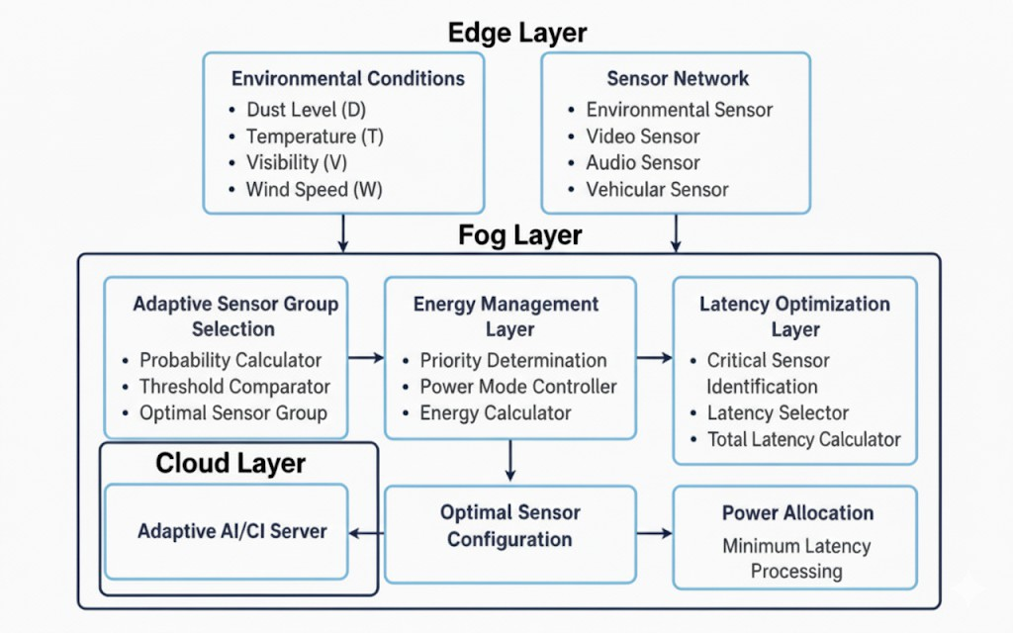

Architecture of the Adaptive AIoT Framework
03

Slide 5

Edge Computing Modules
Modules Implemented in Java (iFogSim) VehicleSimulation.java
ContextGeneratorModule.java AdaptiveAllocatorModule + V2VTransmitterModule
04

Slide 6




Vehicle Simulation Module
It sets up the entire environment – vehicles, fog devices, sensors, actuators, and the communication between them.
It integrates our custom modules (Context Generator, Adaptive Allocator, V2V Transmitter) into the iFogSim simulation.
Workflow
Initialize CloudSim 2.Create Fog Devices
Create Controller
Create Application
sensor → context module → allocator module → V2V module.
Module Placement 6. Add Custom Entities

Slide 7

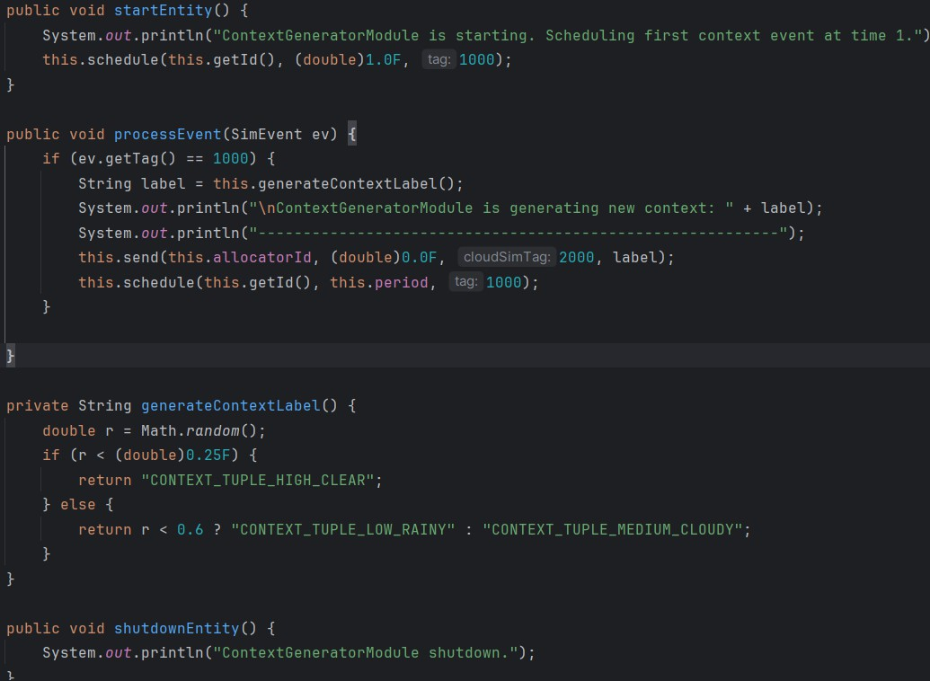
ContextGeneratorModule
Purpose: This is a lightweight module that periodically generates context tuples (Clear, Rainy, Cloudy) to simulate environmental driving conditions.
Workflow processEvent()
Checks if the event tag is 1000.
Generates a new context label (Clear, Rainy, Cloudy)
and sends it to the Allocator Module with tag 2000. Reschedules itself to trigger the next context event after the given period.
generateContextLabel()
Randomly selects an environmental condition based on probability.
Possible outputs:
"CONTEXT_TUPLE_HIGH_CLEAR" (25%)
"CONTEXT_TUPLE_LOW_RAINY" (35%)
“CONTEXT_TUPLE_MEDIUM_CLOUDY" (40%)
Highlight:
This module is the entry point of real-world data in the simulation → it mimics sensors/environment → drives the entire decision-making chain.

Slide 8



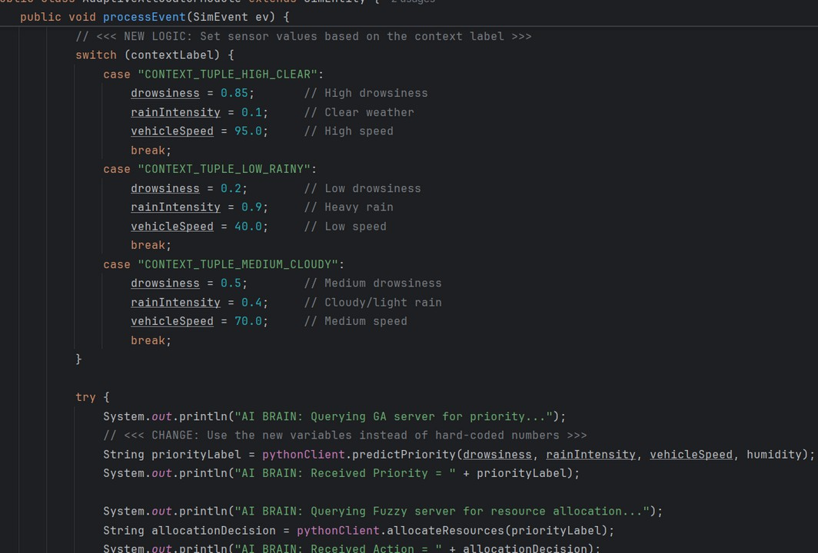



Adaptive Allocator Module
Purpose: Acts as the decision-making unit that integrates Computational Intelligence (GA + Fuzzy Logic) to allocate resources and trigger V2V alerts.
Key Functions & Workflow:
startEntity()
Initializes the allocator module when simulation begins.
processEvent()
Listens for context events (tag 2000).
Calls GA server to assign a priority label (e.g., HIGH, MEDIUM, LOW).
Passes this priority to Fuzzy server for resource allocation decision
If HIGH priority, sends a V2V_ALERT to the V2VTransmitter module (tag 3000).
Highlight
This module connects the Edge simulation (iFogSim) with CI algorithms (Python GA +
Fuzzy) to enable adaptive, real-time decision making.

Slide 9




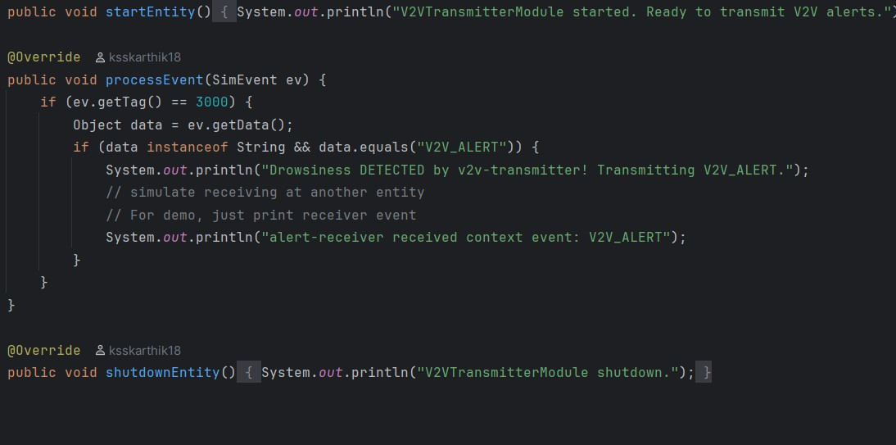
V2VTransmitterModule
Purpose: Handles and transmits V2V alerts when dangerous driving conditions (like drowsiness) are
detected.
Key Functions & Workflow: startEntity()
Initializes the transmitter; ready to send alerts.
processEvent()
Waits for events with tag 3000.
If event = "V2V_ALERT", simulates broadcasting the alert.
Prints/forwards event to neighbor or receiver entity.
shutdownEntity()
Stops the transmitter module at simulation end.
Highlight:
Acts as the final link in the workflow – ensures that critical V2V warnings reach nearby
vehicles/entities for safety response.

Slide 10

PythonClient
Purpose:
Acts as a communication bridge between Java edge modules and Python CI servers (GA + Fuzzy).
Key Functions & Workflow:
predictPriority()
Sends vehicle/environment parameters (drowsiness, rain, speed, humidity)
→ Queries GA server (port 5000)
→ Gets a priority label (HIGH/MEDIUM/LOW).
allocateResources()
Sends the priority label
→Queries Fuzzy server (port 6000)
→Gets a resource allocation decision.
post()
Generic POST request handler that sends JSON payloads and receives responses.
Handles response parsing (extracts fields like "priority" or "decision" from JSON).
Without this client, the Java simulation can’t talk to the AI models. It makes the system hybrid: Edge (Java) + Intelligence (Python).

Slide 11






Computational Framework
Algorithms
Genetic Algorithm (GA): Learns from driving data → evolves rules for priority classification.
Fuzzy Logic :
Maps priority into resource allocation decisions.
Simulation Modules(iFogSim):
Provides synthetic context generation for testing adaptability.
Computation Style:
GA → Optimization-based (evolutionary search) Fuzzy → Rule-based reasoning (human-like inference)
Simulation → Event-driven (dynamic environment modeling)

Slide 12

GA Classifier Server
Purpose:
Uses a Genetic Algorithm (GA) to classify driving conditions into priority levels HIGH / MEDIUM / LOW).
Dataset Loading
Reads priority_dataset.csv containing features such as drowsiness, rain intensity, vehicle speed, and humidity.).
Normalizes and prepares data for GA processing.
GA Evolution Process
Initializes a population of classification rules (chromosomes).
Selection – chooses strong candidate rules.
Crossover – combines rules to form new solutions.
Mutation – introduces diversity for better exploration.
Workflow
Training Output
Iteratively evolves the population to findthe best performing rule set.
Ensures classification accuracy by evaluating fitness on the dataset.
Final best chromosome represents the optimized classifier.
API Service Deployment
Deploys trained GA model via a Flask server endpoint /predict_priority.
Accepts driving condition input, applies the best chromosome,
and returns a priority level as response.

Slide 13

FUZZY PIPELINE IMPLEMENTATION
Purpose: The purpose of using fuzzy logic in traffic monitoring is to dynamically allocate limited edge resources (CPU & bandwidth) based on event priority.
Fuzzy Resource Allocation – Implementation Flow:
The system takes the priority from the Edge/GA module (Low, Medium, or High). Each priority is mapped to a number (Low = 2, Medium = 5, High = 8).
These values are passed through fuzzy membership functions (low, medium, high). A simple rule base is applied:
Low priority → allocate less CPU and bandwidth.
Medium priority → allocate moderate CPU and bandwidth. High priority → allocate maximum CPU and bandwidth.
The fuzzy inference system combines the rules and calculates the outputs.
Through defuzzification, it converts the fuzzy values into exact percentages (e.g., 85% bandwidth, 78% CPU).
The Edge system then uses this output to assign network and CPU resources fairly and efficiently.

Slide 14
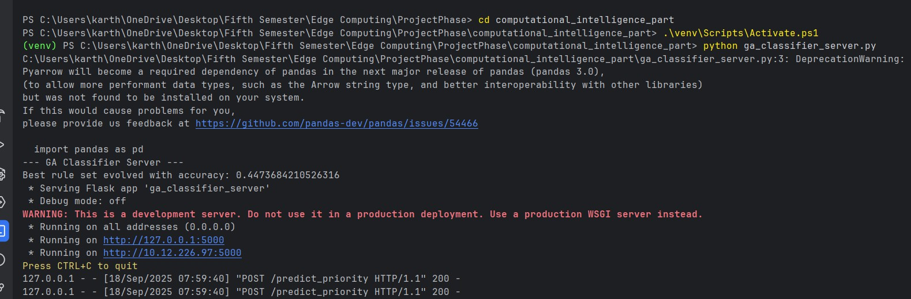
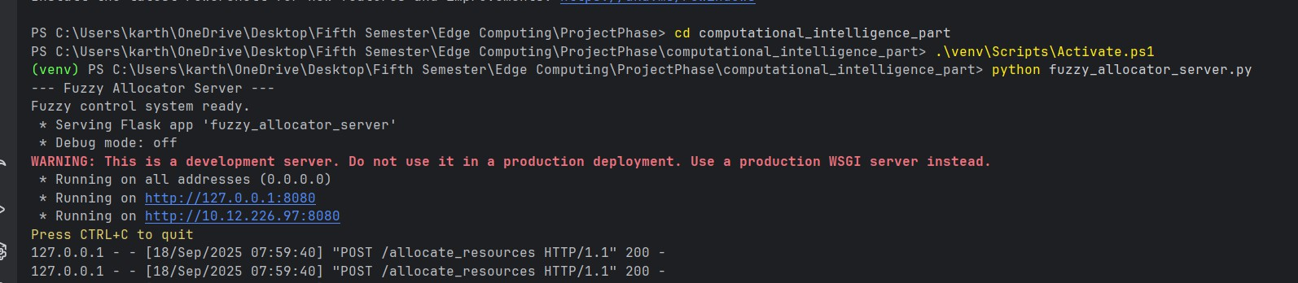
Results

Slide 15
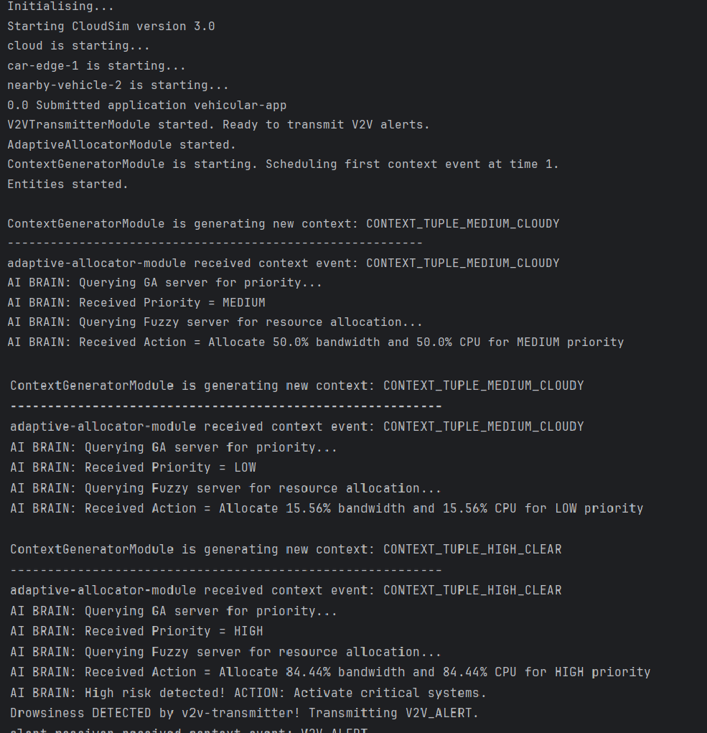
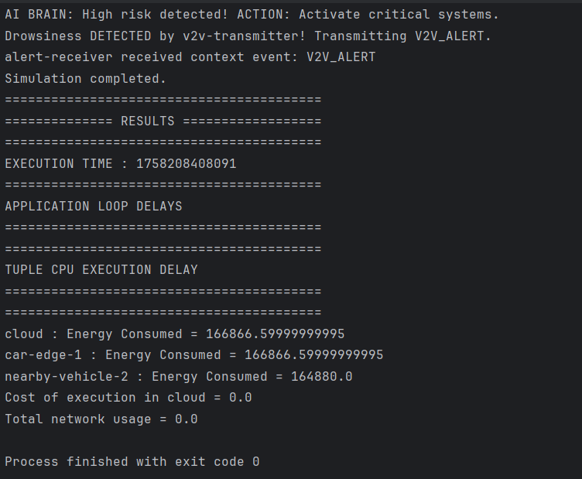

Slide 16
THANK YOU !
TEAM EDGE CB.SC.U4CSE23420(K SUYRA SEKHAR) CB.SC.U4CSE23562(K S SAI KARTHIK) CB.SC.U4CSE23463(K YELLA REDDY)
CB.SC.U4CSE23761(KOUSIK SHARMA)
TEAM CI CB.SC.U4CSE23221 (YOGANAND SARMA)
CB.SC.U4CSE23664 (SANDEEP)

